Slide 1

RFID ACCESS DOOR LOCK
Presented By :
Dilip Meghwal (231210040)
Dilpreet Singh (231210041)
Submitted To
Dr. Karan
(Department of CSE, NIT Delhi)
Project CSE-1(Group-4)
NIT Delhi
Notes:
*
Chandra prakash

Slide 2
INDEX
Problem statement of our project
Solution Proposed
Advantages
About Program
Hardware Components
Implementation
Arduino Program
Result / Outcome
Our Learning / Problem Faced
Future Work
Demo
NIT Delhi
*

Slide 3
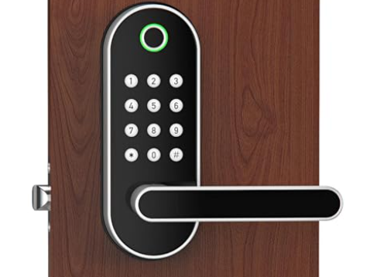

Problem Statement
"Existing door locking methods, such as keys and passcodes, are susceptible to security breaches through loss, theft, or unauthorized sharing. These vulnerabilities compromise the safety of premises. A solution is needed to enhance security and convenience in access control systems."
NIT Delhi

Slide 4
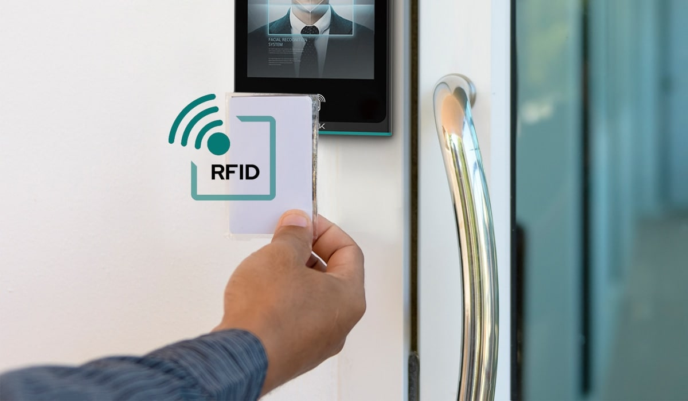
Solution Proposed
"Our proposed solution is to implement an RFID door lock system. Utilizing RFID technology, each authorized individual will be provided with a unique RFID tag or card, granting them access to the premises. The system will be integrated with a secure database to manage access permissions effectively. This solution enhances security by eliminating the risks associated with lost or shared keys and passcodes, while also offering convenience and scalability for various access requirements.
NIT Delhi
*

Slide 5
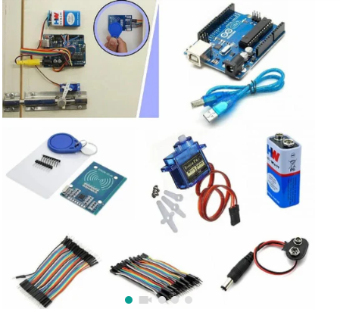
ABOUT PROJECT:- HARDWARE REQUIREMENTS
Arduino UNO board
RFID reader module (e.g., MFRC522)
Servo motor
RFID tags or cards
Jumper wires
Power supply (a 9V battery)
Ultrasonic Sensor (HC-SR05)
Buzzer
NIT Delhi
*

Slide 6
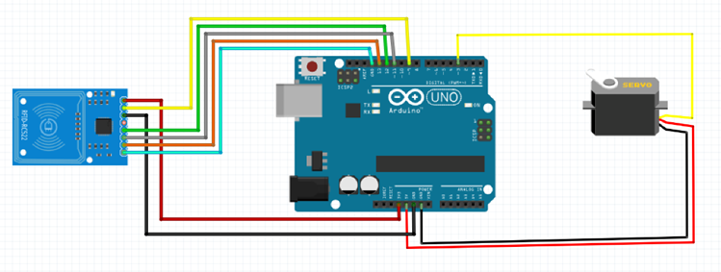
ABOUT PROJECT:- IMPLEMENTATION
1. Setting up the Arduino Environment
2. Installing Libraries
3. Connecting Components
4. Writing Arduino Code
5. Uploading Code to Arduino
6. Testing and Calibration
7. Assembling and Installing
NIT Delhi
*

Slide 7
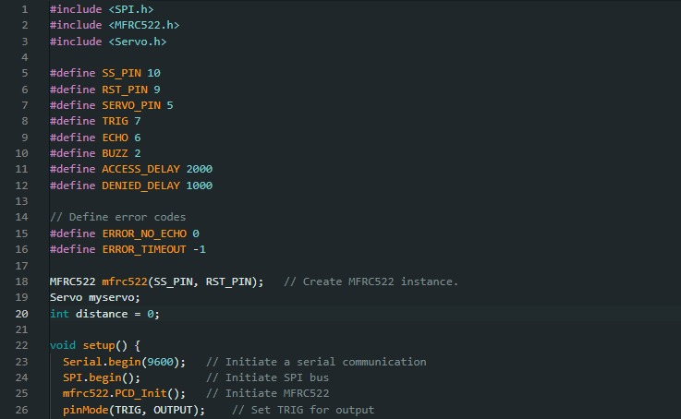
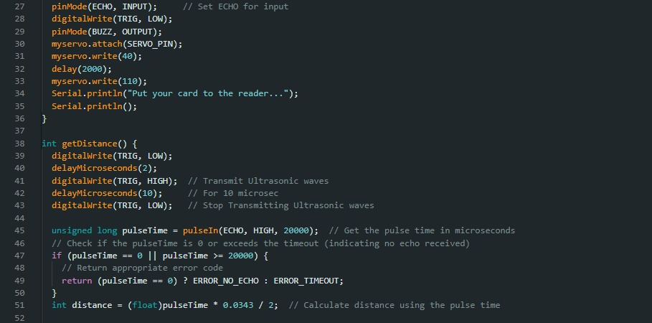
ABOUT PROJECT:- ARDUINO CODE

Slide 8
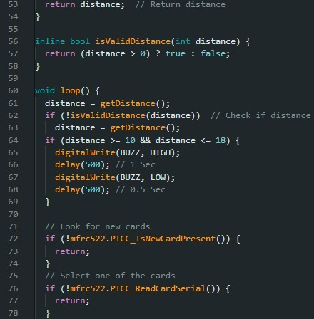
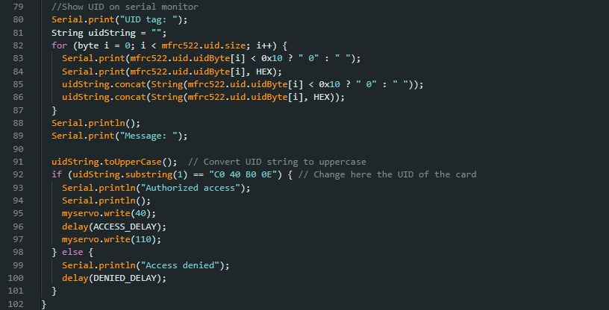
ABOUT PROJECT:- ARDUINO CODE

Slide 9
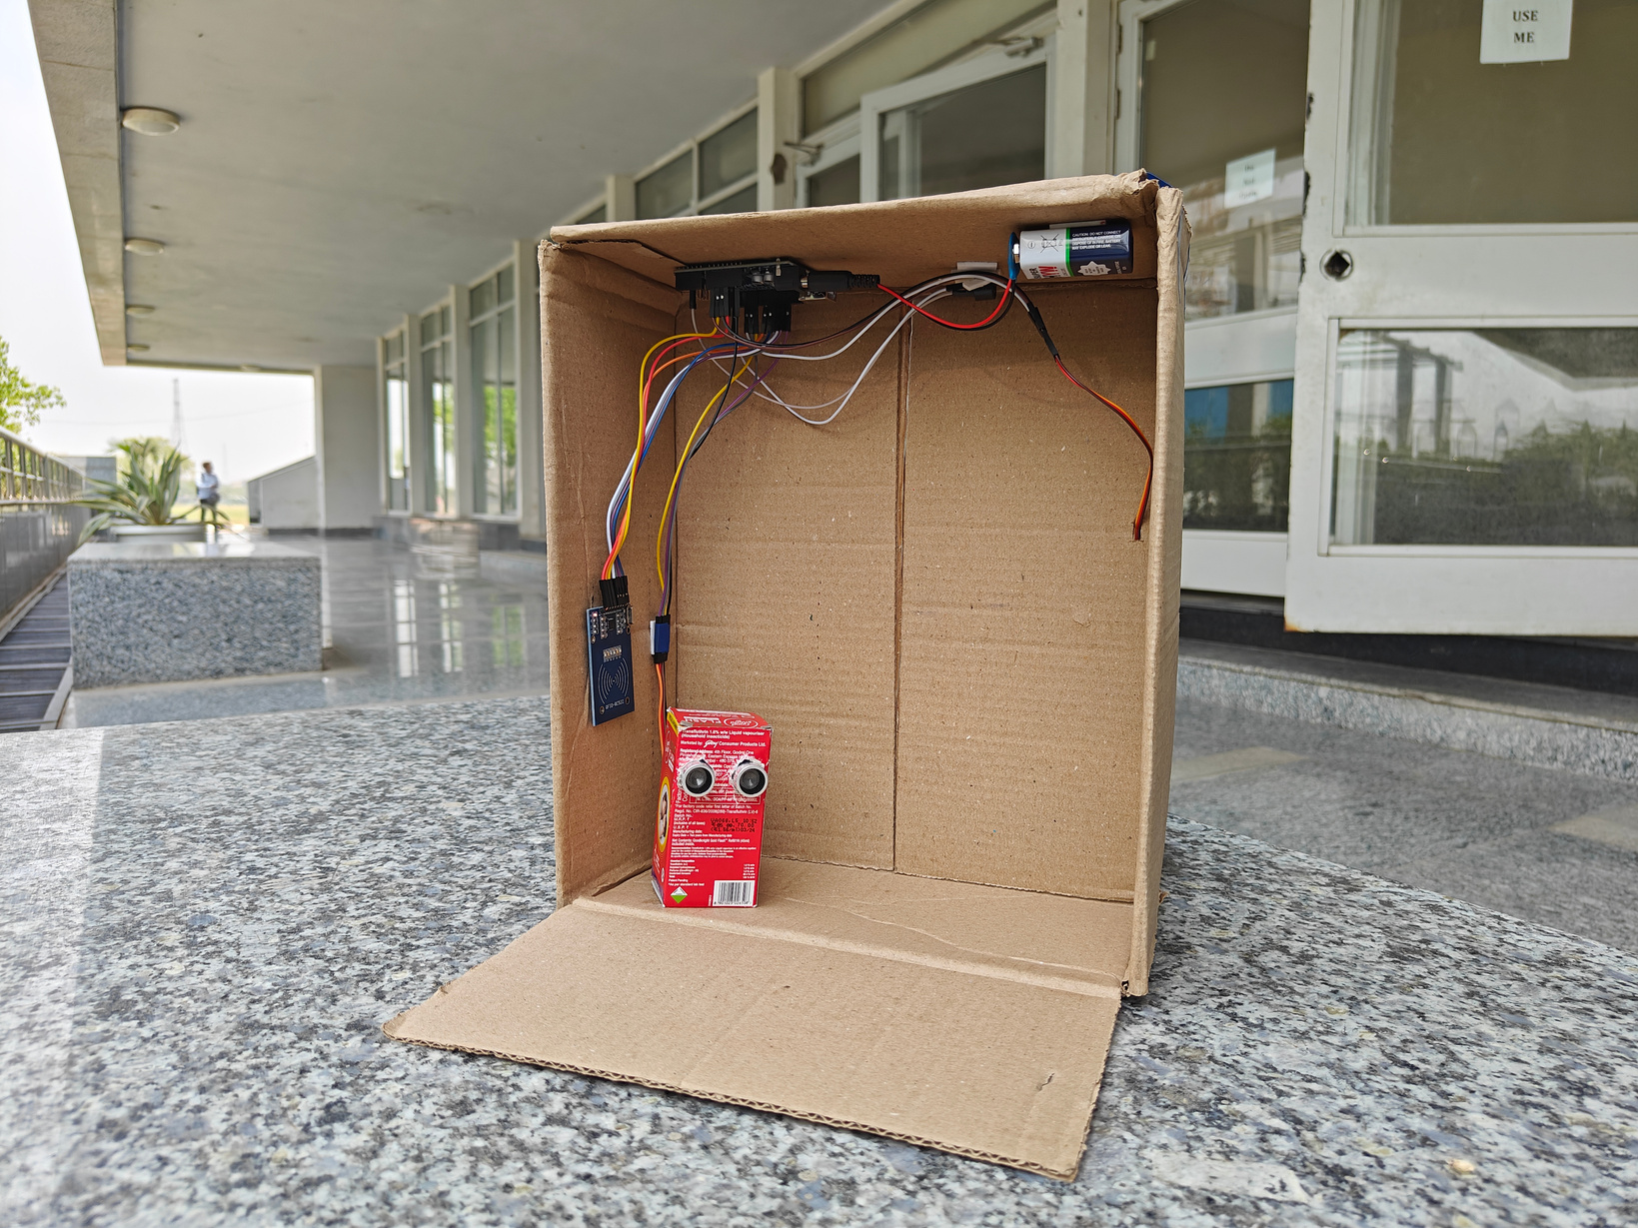
RESULT
This RFID Access Door Lock system will allow authorized users to unlock the door with RFID tags/cards.
NIT Delhi
*

Slide 10
OUR LEARINING
Understanding RFID technology: Learning about how RFID works, its components, and its applications.
Arduino Programming: Learning about Arduino programming and respective libraries related to RFID technology.
MFRC522 library that facilitates communication between a microcontroller and the MFRC522 RFID reader module.
Servo library that can be utilized to control a servo motor that operates the locking mechanism.
Circuit design: Learning about basic electronic components and circuitry required for interfacing RFID readers with microcontrollers.

Slide 11
PROBLEM FACED
Technical challenges: We encounter difficulties in understanding and implementing the technical aspects of RFID technology, such as interfacing RFID readers with microcontrollers or processing RFID data.
Software bugs and debugging: Debugging errors in the software code, such as syntax errors, logical errors, or compatibility issues between different software components.
Hardware issues: Dealing with hardware-related problems, such as faulty connections, or compatibility issues between different hardware modules.

Slide 12
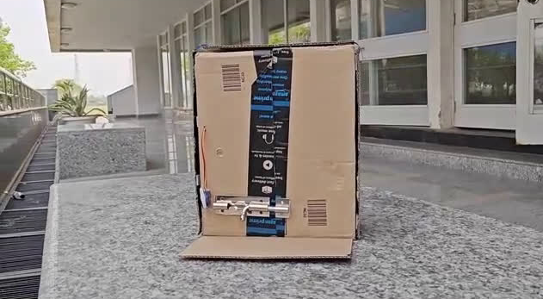
VIDEO PRESENTATION
NIT Delhi
*

Slide 13
FUTURE WORK
Potential enhancements for the project include:
Adding multiple user support with different access levels.
Implementing access logs and notifications for security monitoring.
NIT Delhi
*

Slide 14
THANK YOU
NIT Delhi
*

